Slide 1
Smart alarm
clock
Цветомир Стайков
2 курс КН
1MI0800469

Slide 2
Smart alarm
Цветомир Стайков
2 курс КН
1MI0800469
clock

Slide 3

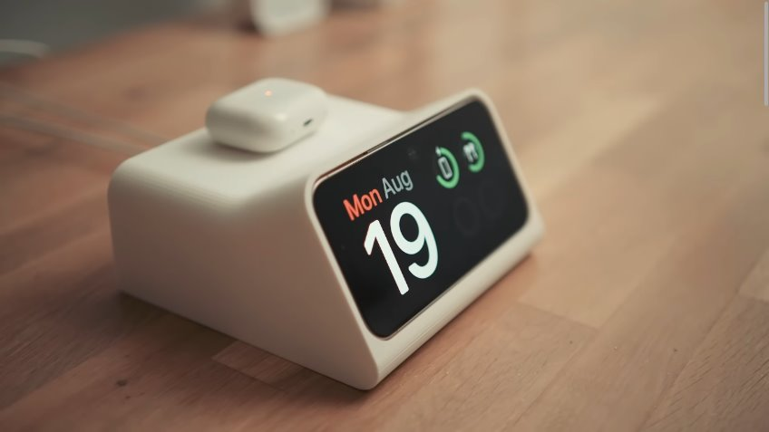
phone app for tracking sleep
Standby dock for Iphone
by Scott Yu-Jan and OVERWERK

Slide 4
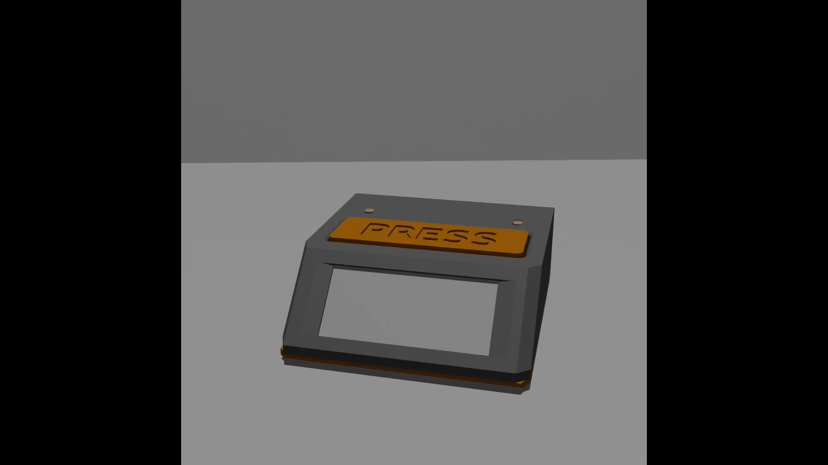

Slide 5
3d принтиран дизайн
Материал:
PLA оранжево & сиво
Време за принтиране:
~ 6 часа + тестове
Време за разработка:
~ 2 дена

Slide 6
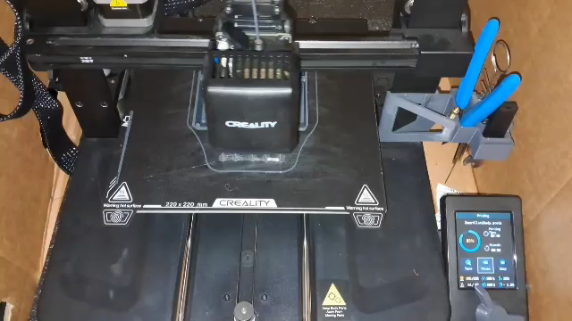
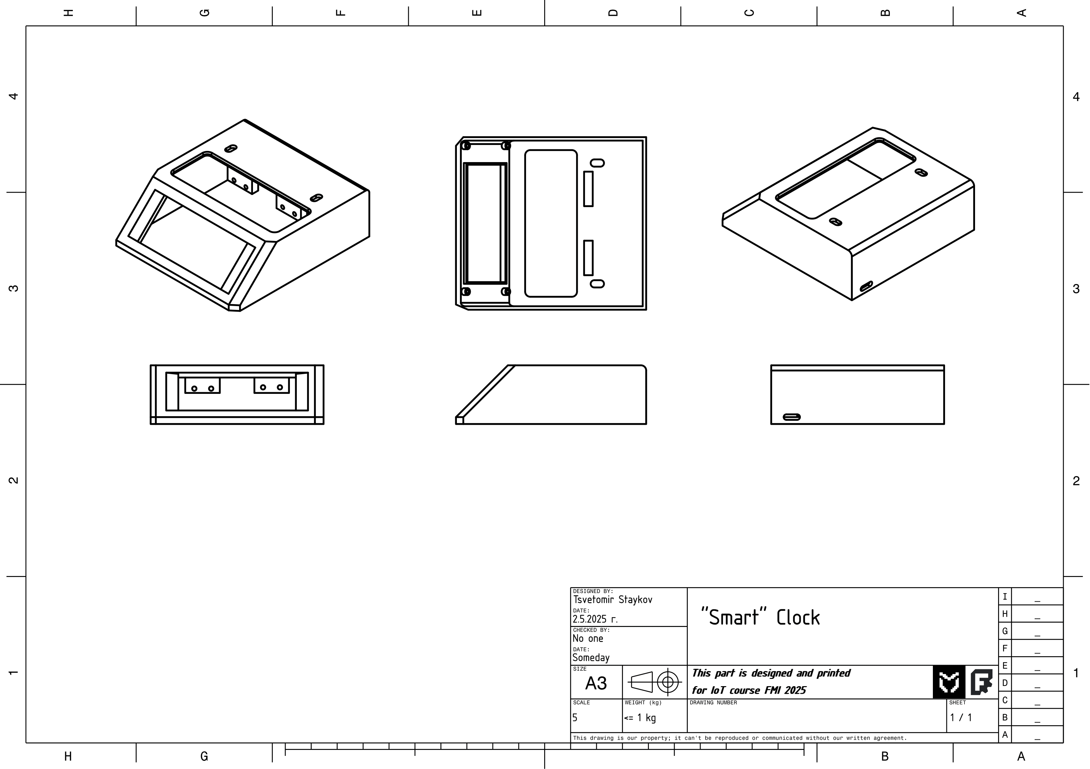

Slide 8
3d принтиран дизайн
Материал:
PLA оранжево & сиво
Време за принтиране:
~ 6 часа + тестове
Време за разработка:
~ 2 дена

Slide 10
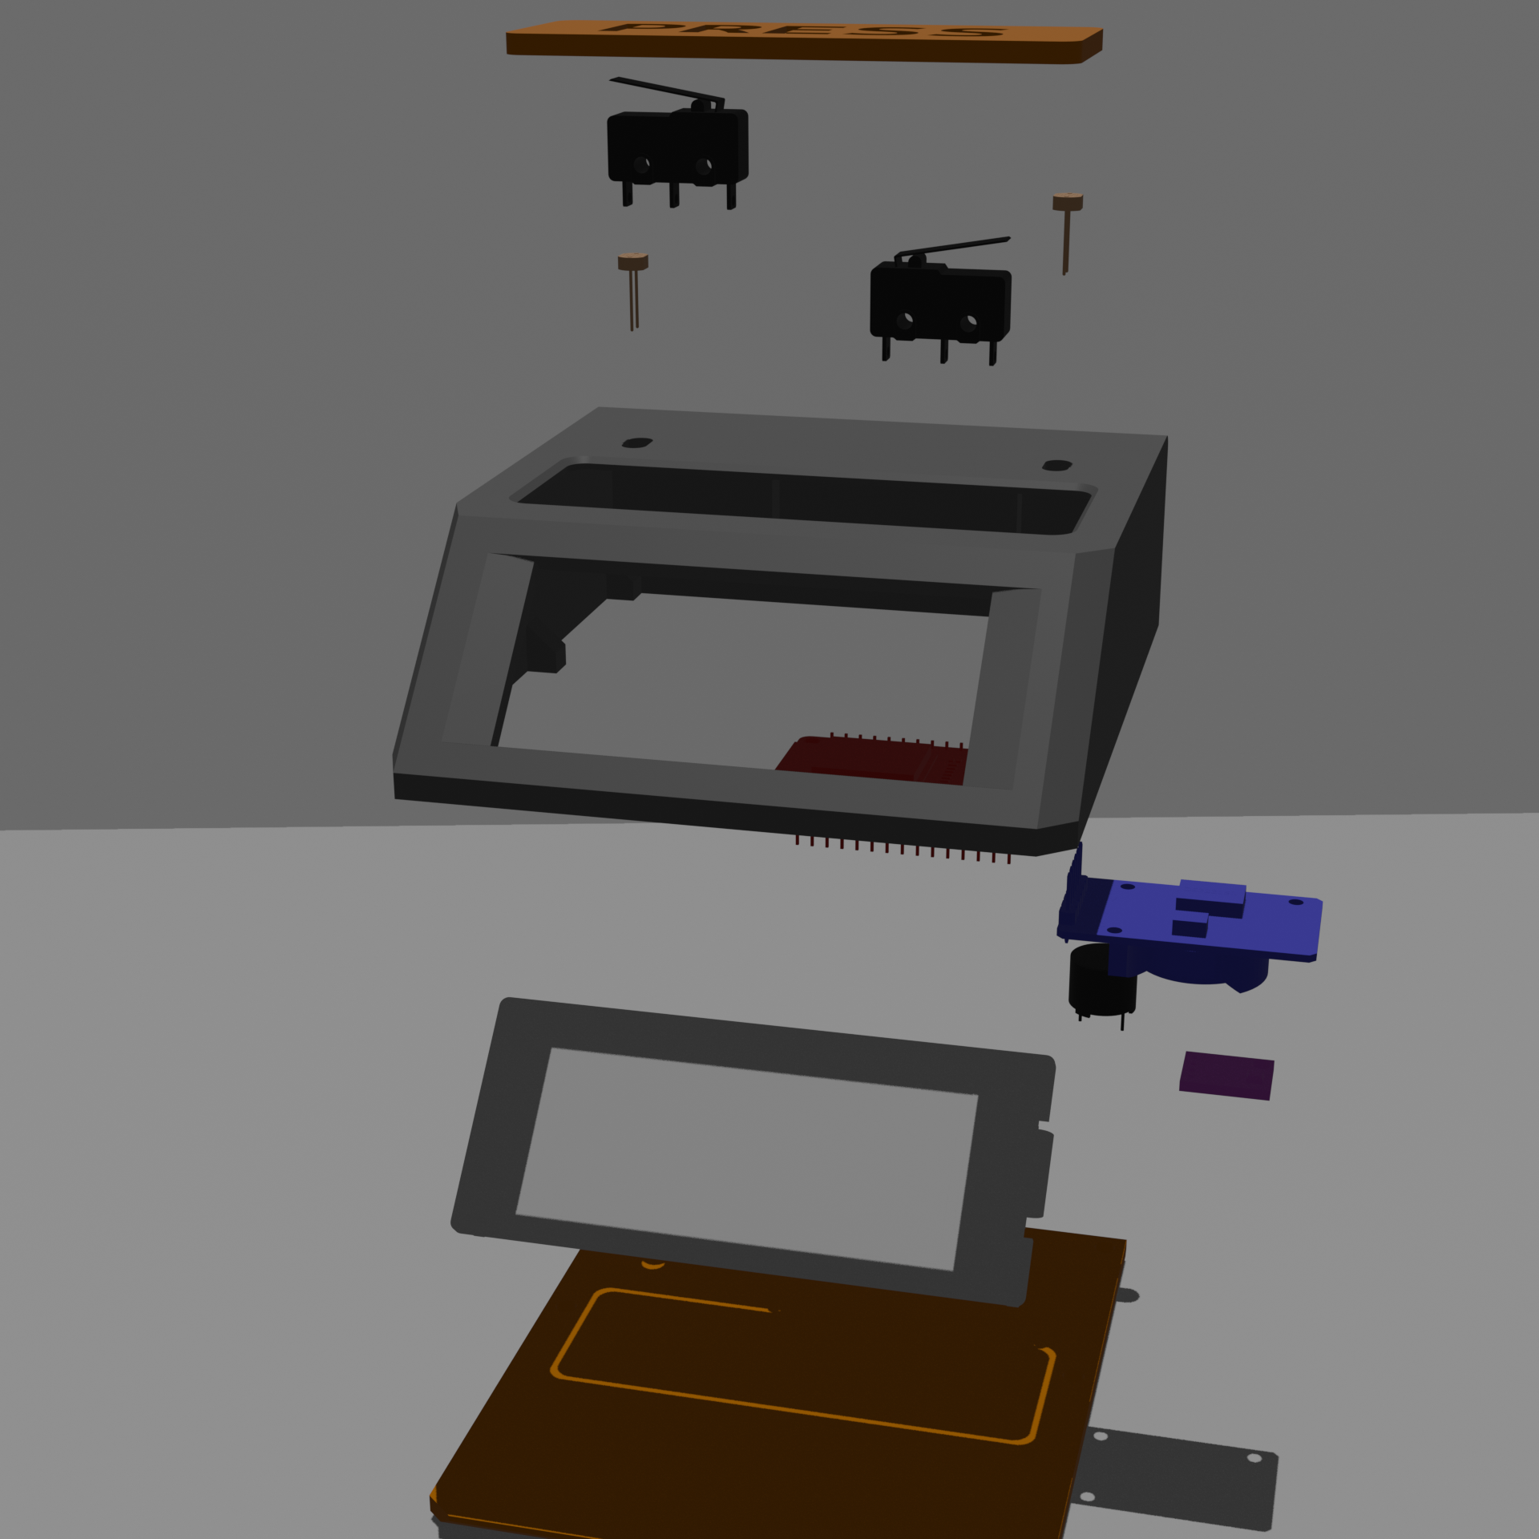

Slide 11
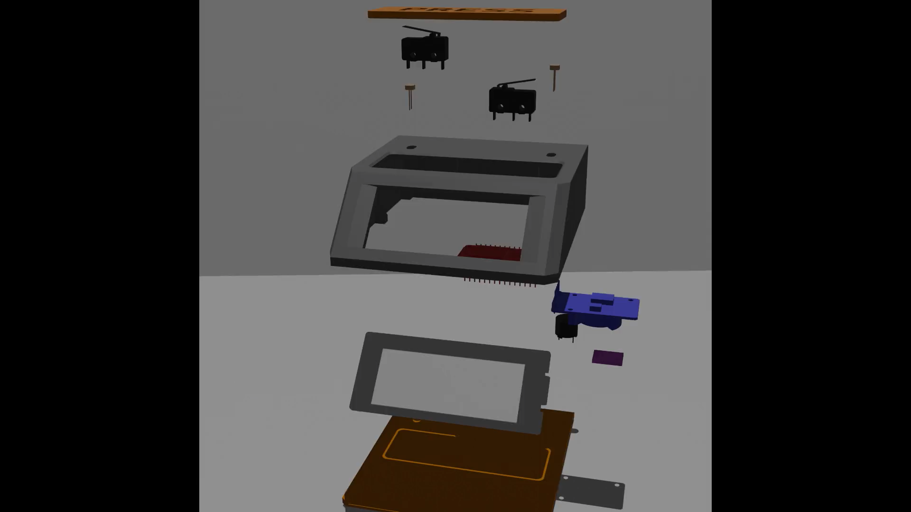

Slide 12
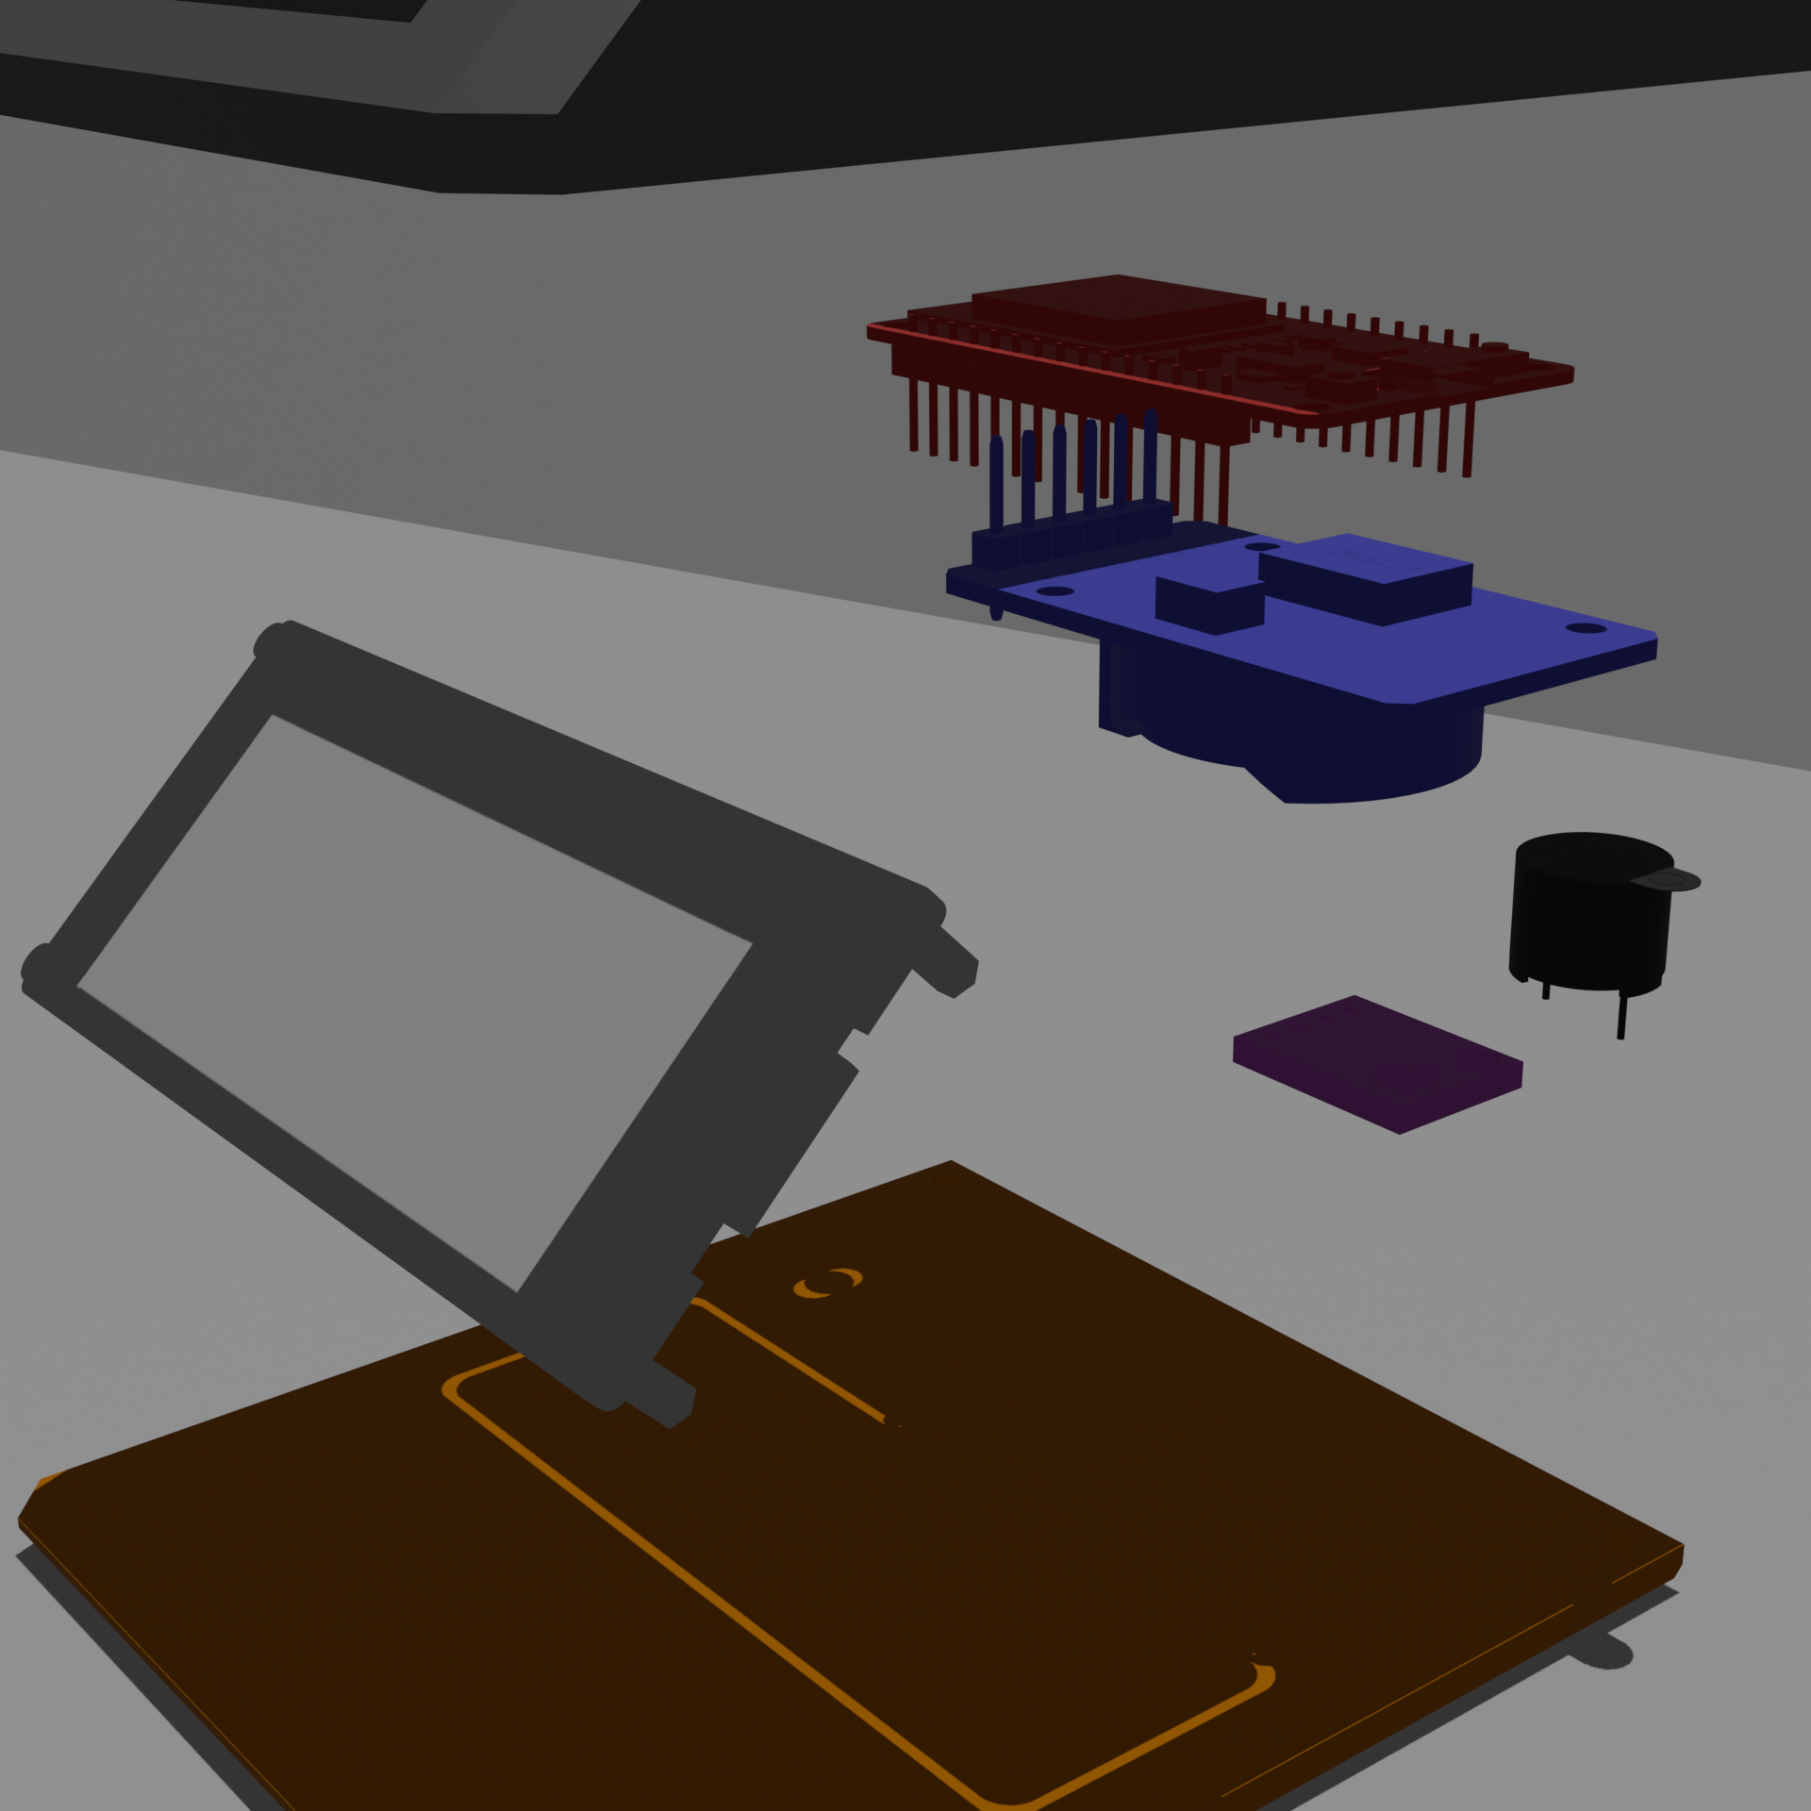
2.9 inch
E-ink display
By Waveshare

Slide 13
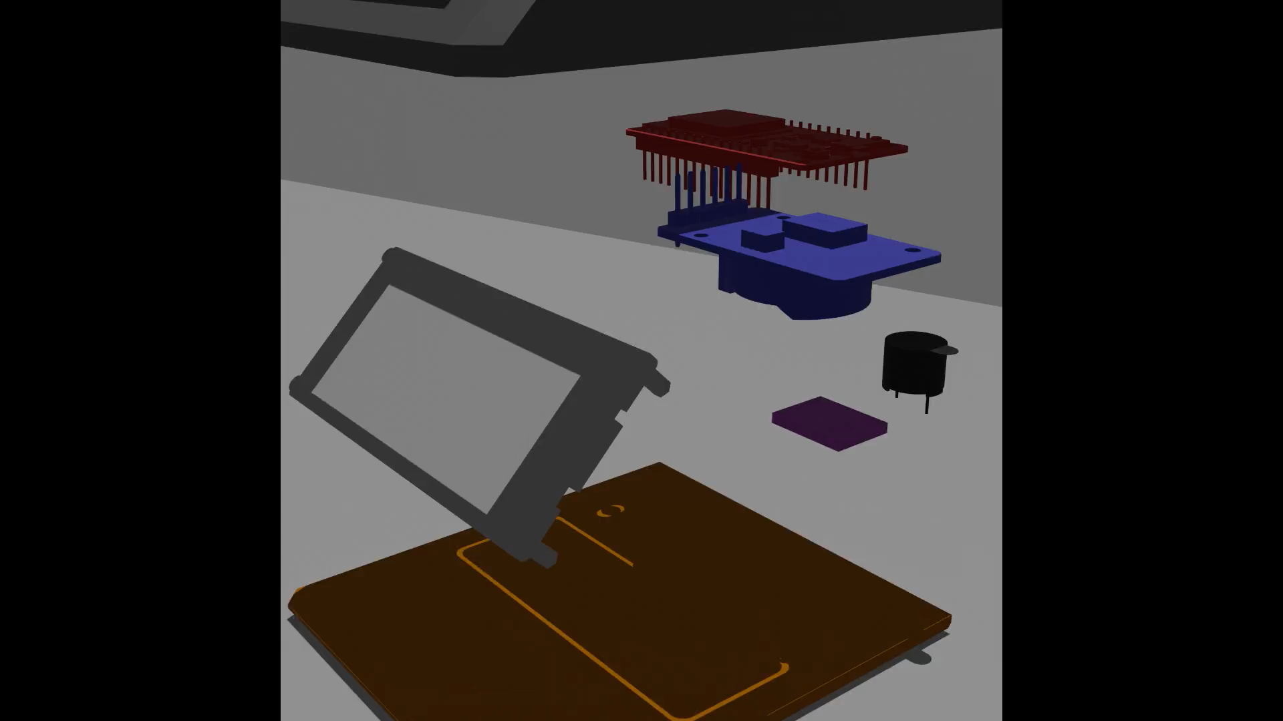

Slide 14
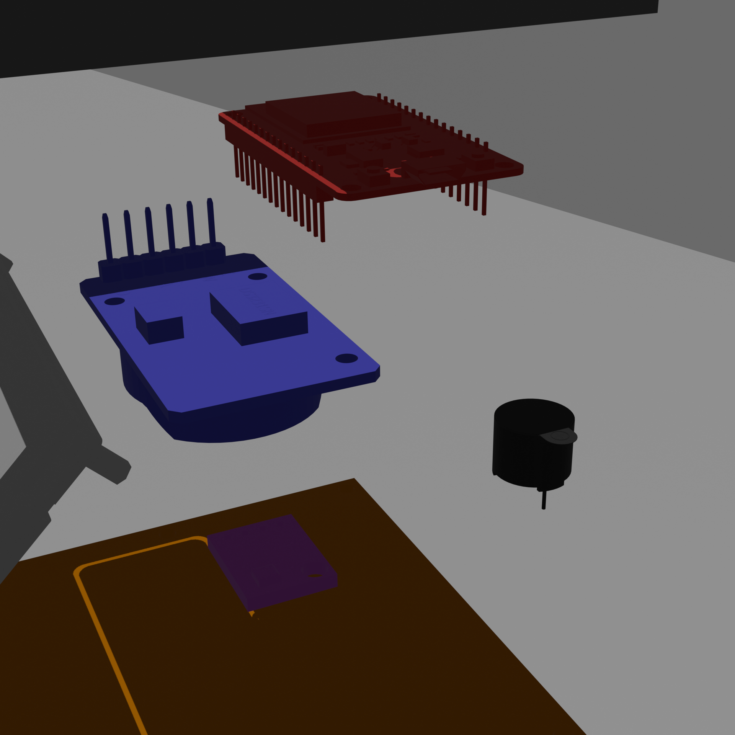
Real Time Clock module
ESP32
By olimex
BME280 sensor for temperature, pressure, humidity
5v buzzer

Slide 15
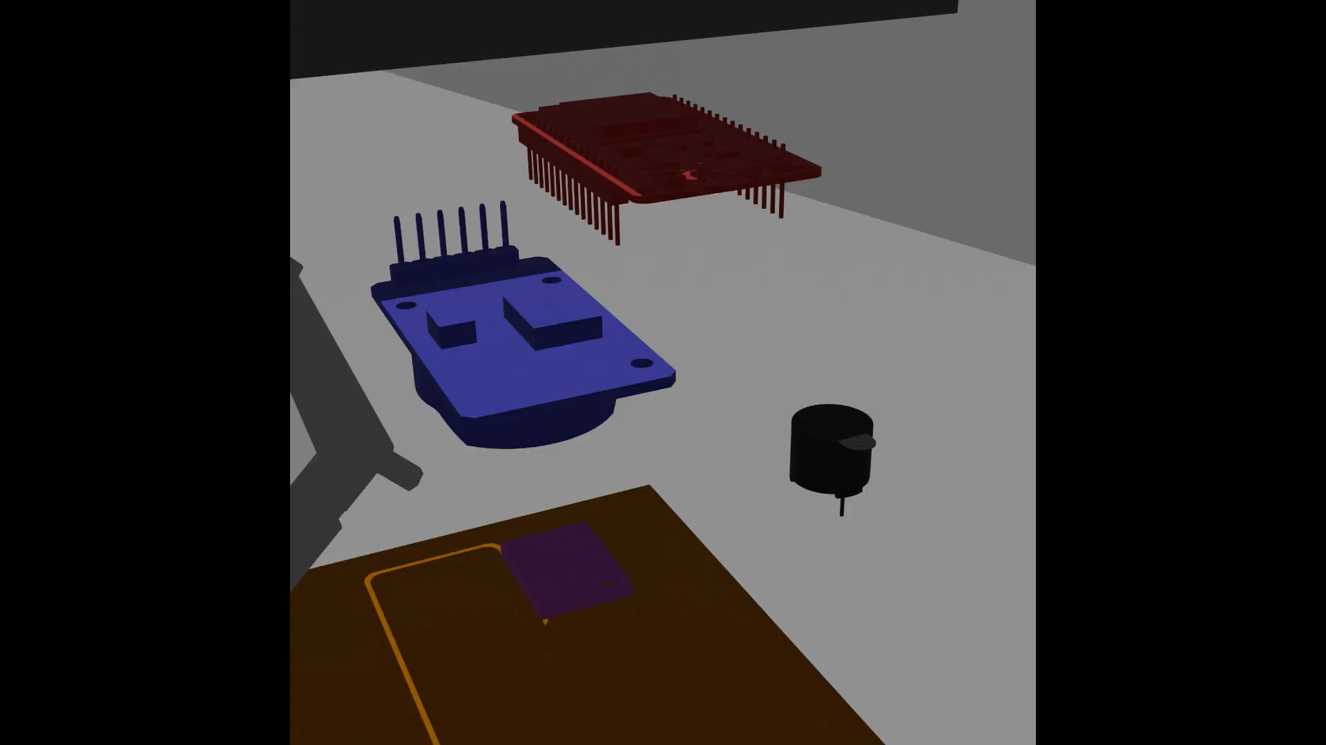

Slide 16
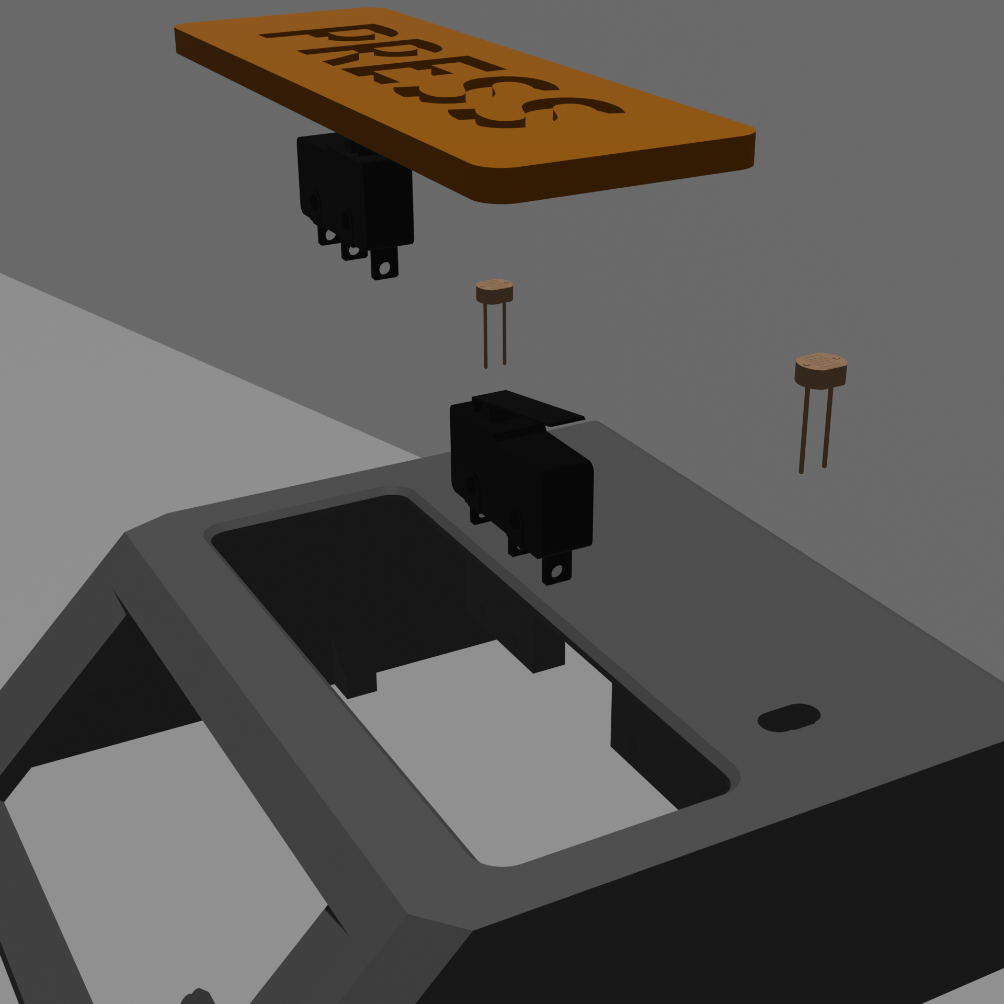
Photoresistors
Switches

Slide 17
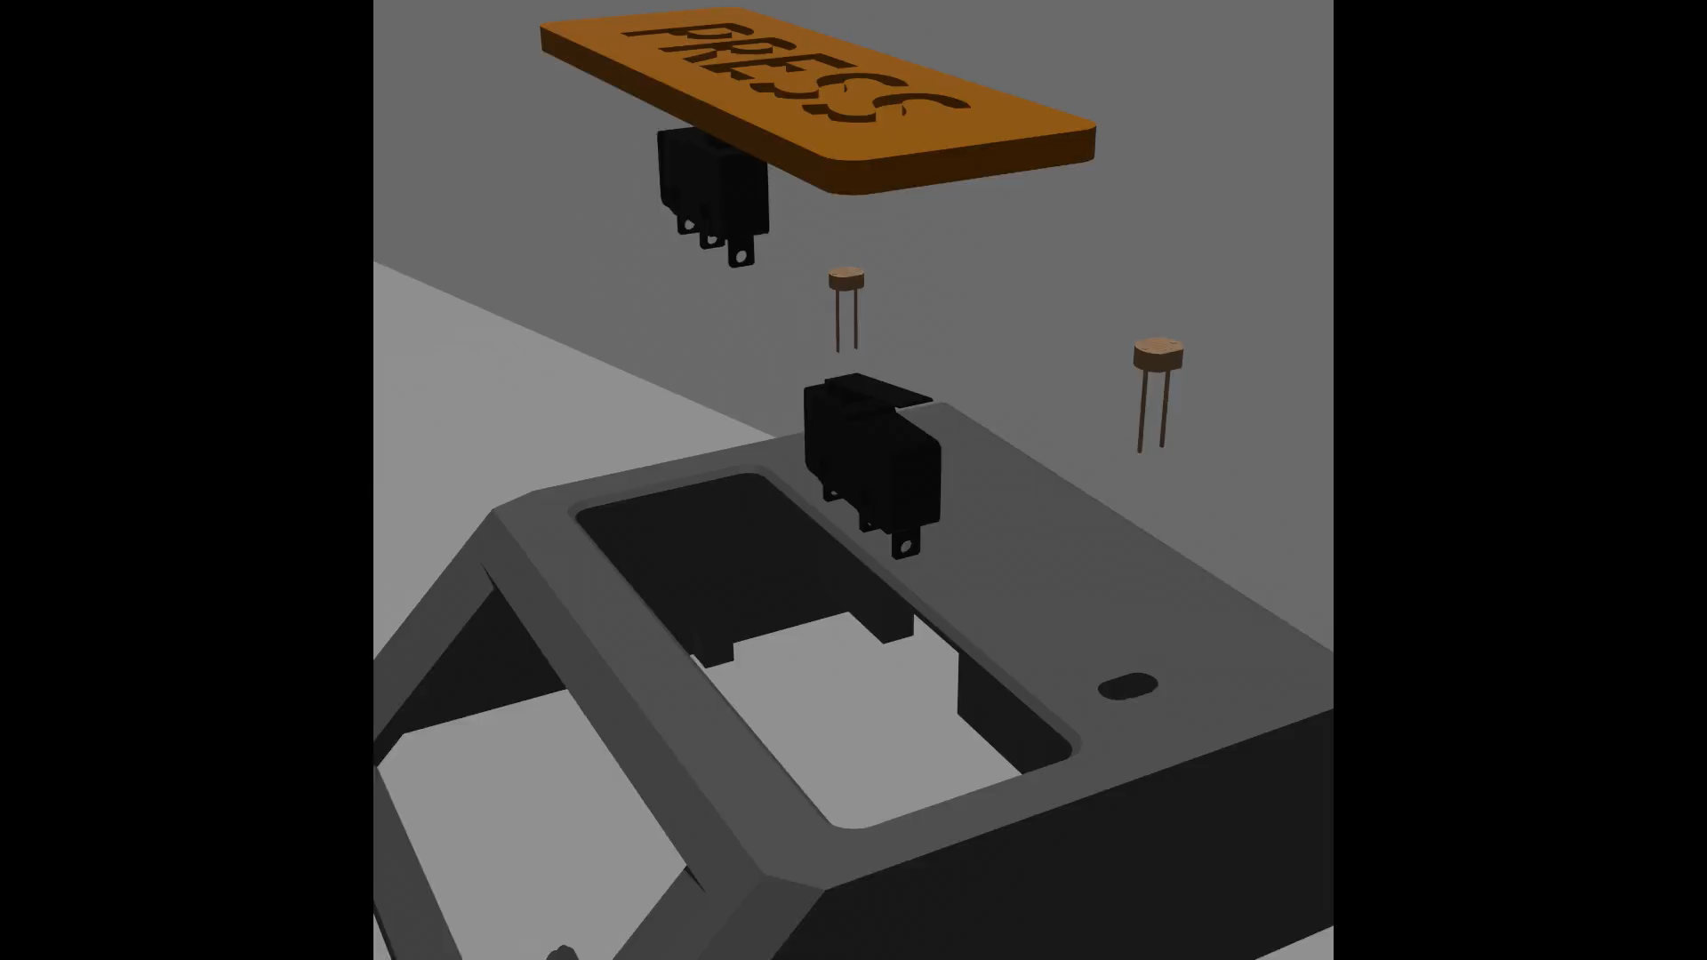

Slide 18
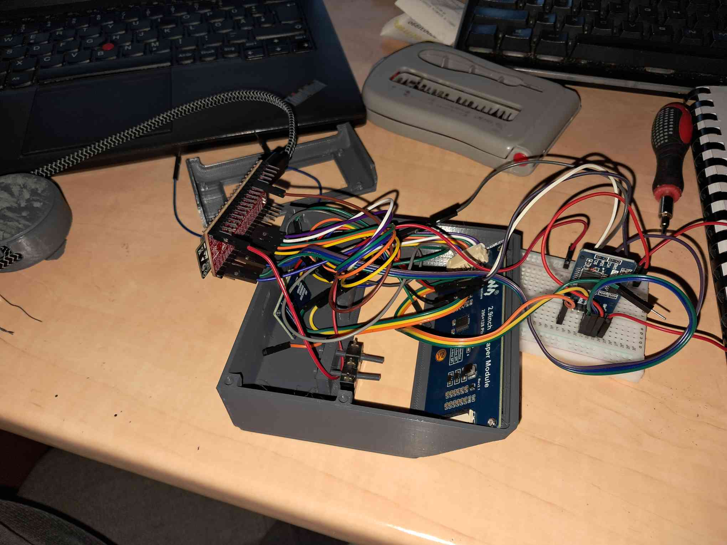

Slide 19
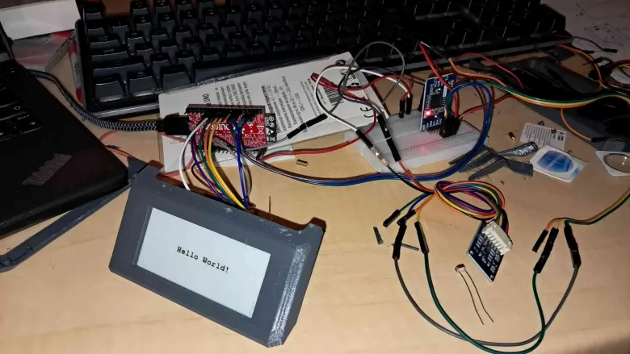

Slide 20
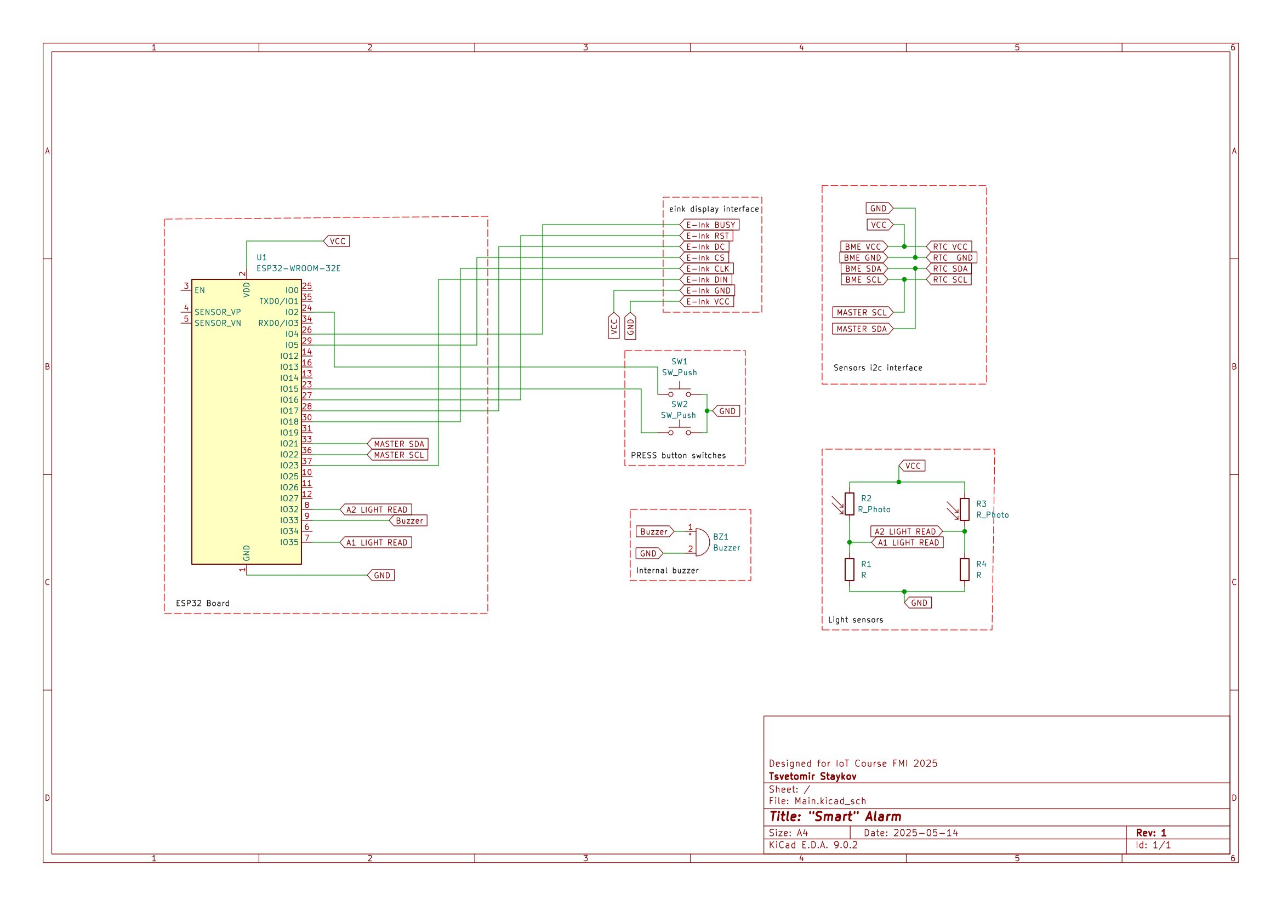

Slide 21
Original list of components:
ESP 32
Switches
Photoresistors
BME280 sensor
RTC module
/ 7 segment display
E-ink display 2.9 inch
Analog Microphone
Sd card reader
Speaker

Slide 22
Original list of components:
ESP 32
Switches
Photoresistors
BME280 sensor
RTC module
E-ink display 2.9 inch
/ 7 segment display
Analog Microphone
Sd card reader
Buzzer

Slide 23
RTCModule
Display
Display pages
Alarm
Environmental sensors
Logic
Main
Libraries
Logger
Software
api
pins
Wifi
WebPage
Weather

Slide 24
RTCModule
Display
Display pages
Alarm
Environmental sensors
Main stuff
Logic
Main
Libraries
Logger
api
pins
Wifi
WebPage
Weather

Slide 25
Main stuff
Other main stuff
Logic
RTCModule
Main
Display
Libraries
Logger
Display pages
api
pins
Wifi
Alarm
WebPage
Environmental sensors
Weather

Slide 26
Main stuff
Other main stuff
Logic
RTCModule
Main
Display
Libraries
Logger
Display pages
api
pins
Wifi
Alarm
WebPage
Environmental sensors
Weather
wifi stuff

Slide 27
Main stuff
Other main stuff
Logic
more stuff
RTCModule
Main
Logger
Display
Libraries
Display pages
api
Alarm
pins
Wifi
WebPage
Environmental sensors
Weather
wifi stuff

Slide 28
Module and sensor control
Logic and initial
Logic
Support libraries
RTCModule
Main
Logger
Display
Libraries
Display pages
api
Alarm
pins
Wifi
WebPage
Environmental sensors
Weather
Wifi stack

Slide 29
Module and sensor control
Logic and initial
Logic
Support libraries
RTCModule
Main
Logger
Display
Libraries
Display pages
api
Alarm
pins
Wifi
WebPage
Environmental sensors
Weather
Wifi stack

Slide 30
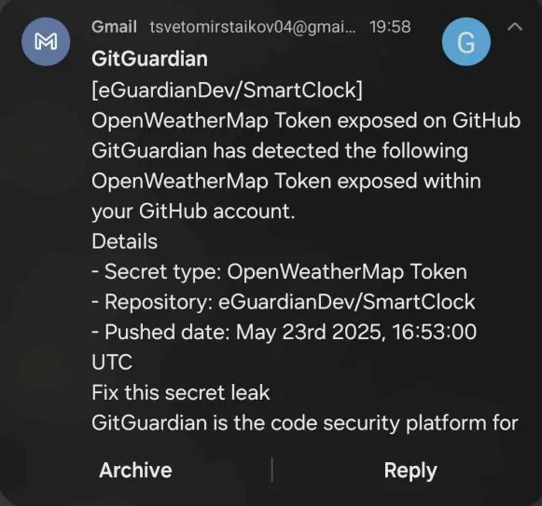

Slide 31
Module and sensor control
Logic and initial
Logic
Support libraries
RTCModule
Main
Logger
Display
Libraries
Display pages
api
Alarm
pins
Wifi
WebPage
Environmental sensors
Weather
Wifi stack

Slide 32
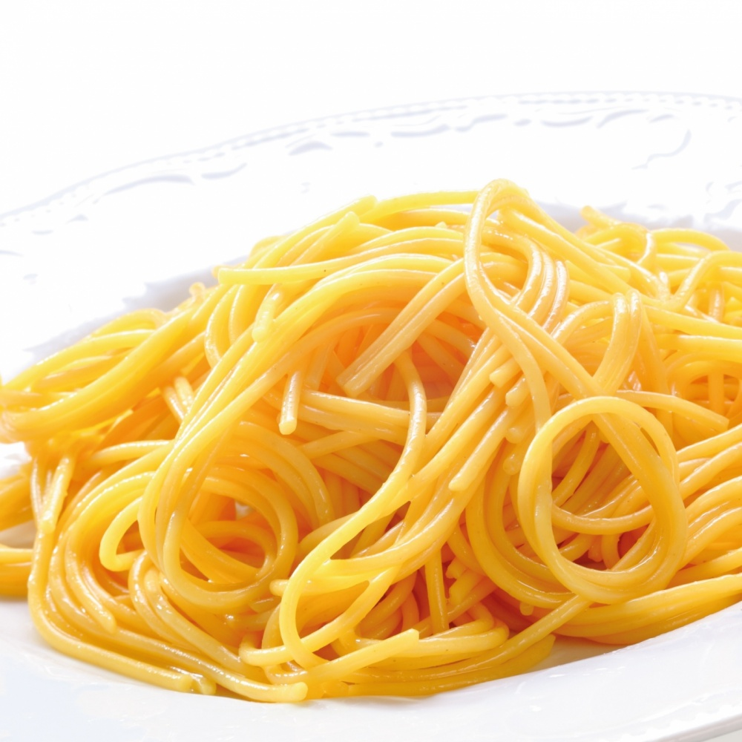
Logic
RTCModule
Main
Display
Logger
Display pages
Alarm
Environmental sensors
Libraries
Wifi
api
WebPage
pins
Weather

Slide 33
Code architecture style:
Custom, event based, side effects
Also known as:
BAD CODE
There are too many public variables, please don’t do this. Use normal event based programming and don’t use side effects, it gets really confusing.

Slide 34
Demo

Slide 35


Used tools to make the project
Photopea
Bitmap editing
OpenWeatherMap API

Slide 36



Used tools to make the project
Photopea
Bitmap editing
Blender
animation
OpenWeatherMap API
KiCAD
electronics schematics
FreeCAD
Box design

Slide 37
Thank you for your attention!
Questions?

Slide 38
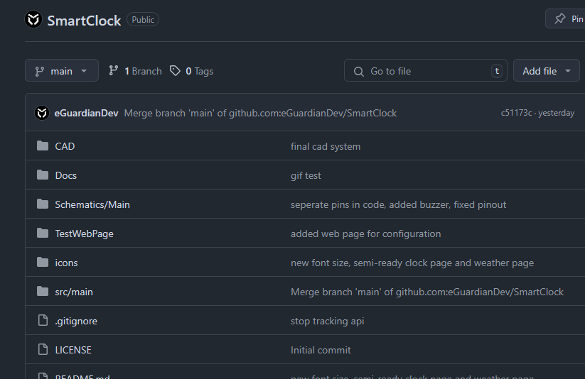

github.com -> eGuardianDev -> SmartClock

